Slide 1
Website optimization

Slide 2
Suggestions
1. Host static files on CDN(images)
2. Cache for images
3. Minify js
5. Adjust js loading order
6. Reduce/Merge js files
7. Lazyload
8. Adjust image size
9. Using some new image formats like Webp,Jpeg 2000 etc.

Slide 3
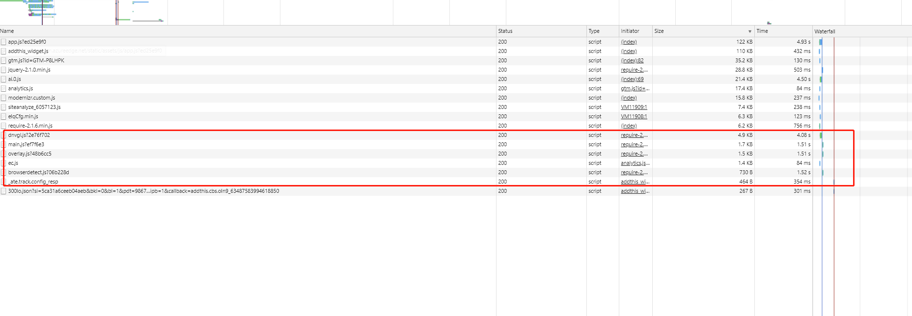
JS
1.Merging existing small js files into a medium one and get it minified
eg:

Slide 4
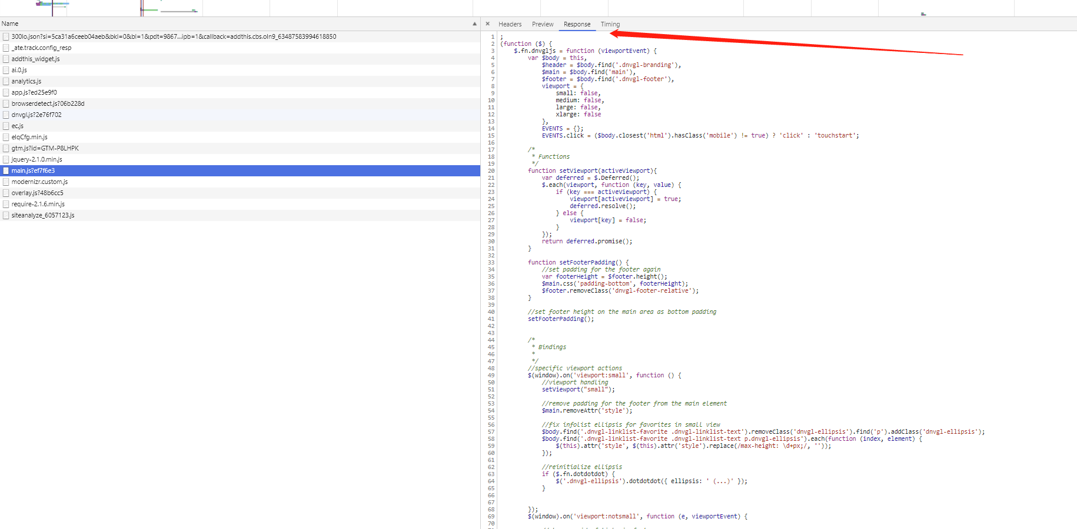
JS

Slide 5
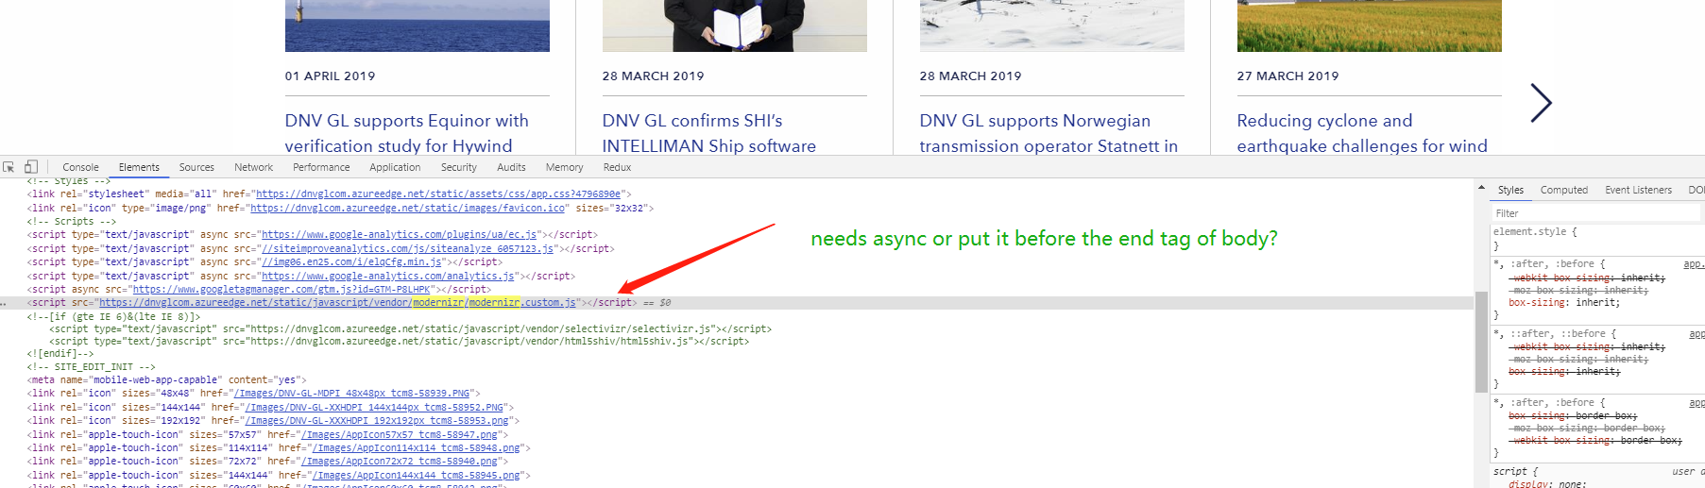

JS

Slide 6
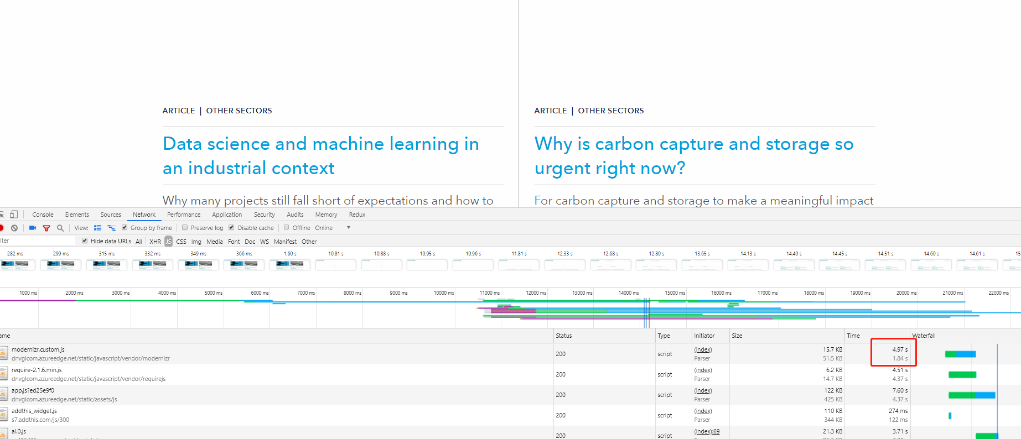

Slide 7
Images
1.Lazyload
Initializing with pictures with lower quality and make sure user can at least see the related pictures when visit the website(Like for banner images) and at the mean time spend async calls to fetch the pictures with higher quality then make replacement

Slide 8
Images
2. Adjust image size to a proper size(Also the same for mobile side)

Slide 9
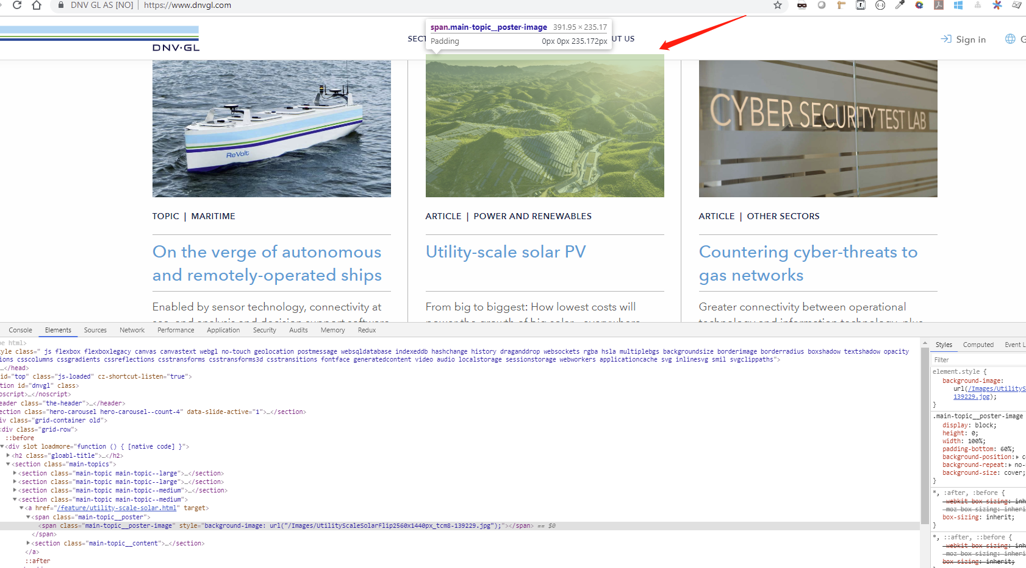
Size of picture we need in the page

Slide 10
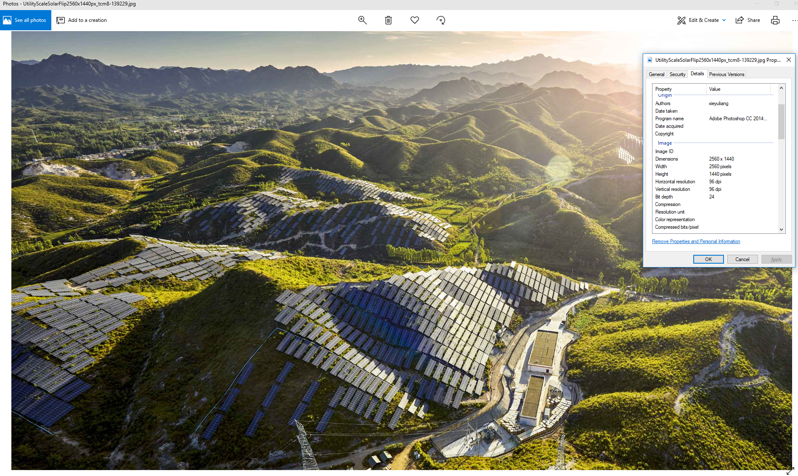
Actual image we load:

Slide 11
Others
Webp:
This can reduce the file size with the same quality, but only have a better support for chorme (We may enhance the performance for chorme if needed)
DEMO
Bpg:
Can reduce the file size effectively but the same problem with Webp, and the need encode/decode with may cost extra time and needs to quote extra js
DEMO

Slide 12
Thank you
Bran Gu
Xie.haib.bran.gu@dnvgl.com

